Slide 1

Bank Churners
IST 707 Applied Machine Learning Renjini Rajan Amanda Norwood
This Photo by Unknown Author is licensed under CC BY-NC-ND

Slide 2
Introduction
Goals
Time is money! Our dataset focuses on current and past credit card customers
The dataset contains demographic information regarding the customers and their credit card and banking behavior

Slide 3
Goals
Identify key factors that influence customer churn
1
Evaluate effectiveness of retention strategies
2
Develop actionable insights
3
Notes:
1: It is important to determine the root cause of customer churn and identify specific factors that have the greatest impact on customer retention. Overall, this would help banks develop targeted strategies to reduce churn.
2: Once a strategy is in place, it is important to evaluate the effectiveness to refine the approach.
3:The goal is to develop actionable insights that can improve customer retention

Slide 4
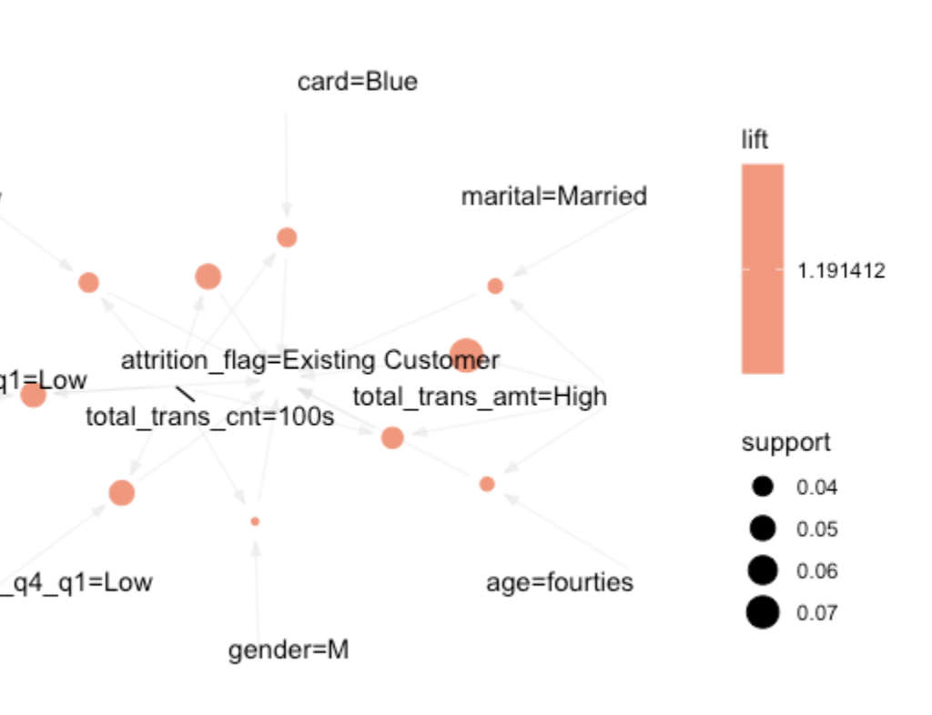
APRIORI: EXISTING CUSTOMERS
Customers tend to stay with the bank when:
Transaction amounts are high
Transaction counts are higher (100s)
They have a combination of both high amounts and counts
Customer age in the 40s
Generally male

Slide 5
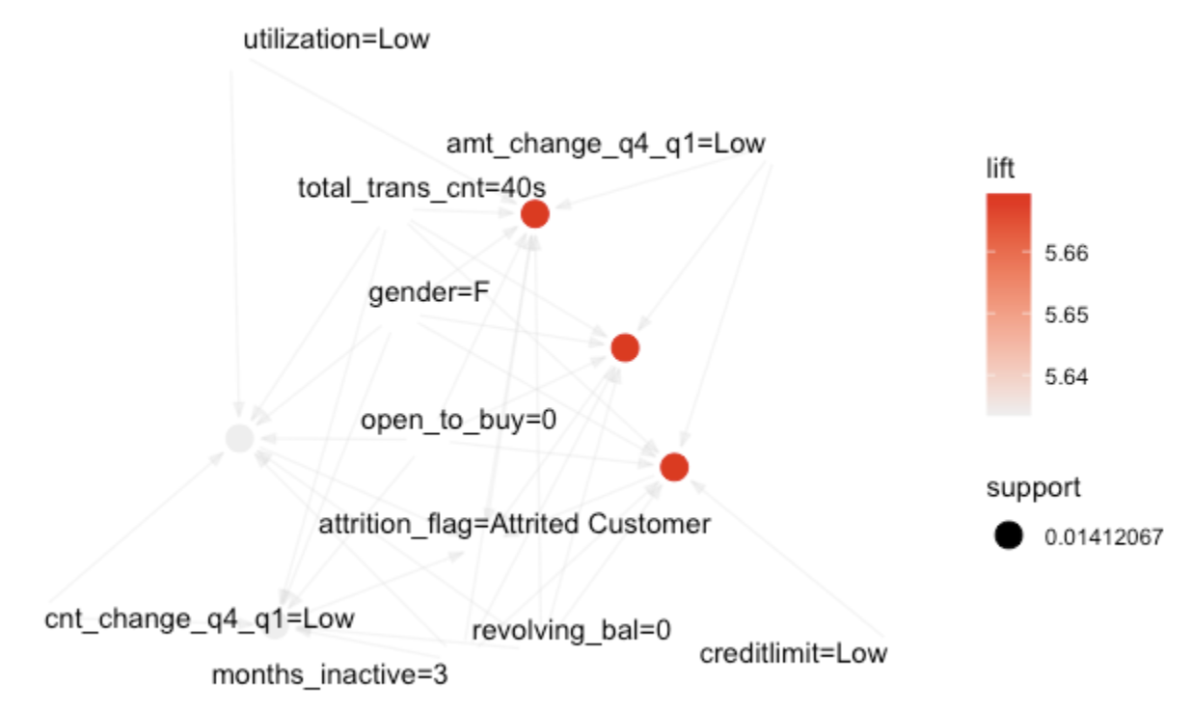
APRIORI: PAST CUSTOMERS
Customers have less number of contacts/interactions from the bank
Customers have transaction counts in the 40s
Customers that are relatively new
Show no utilization for at least 3 consecutive months

Slide 6
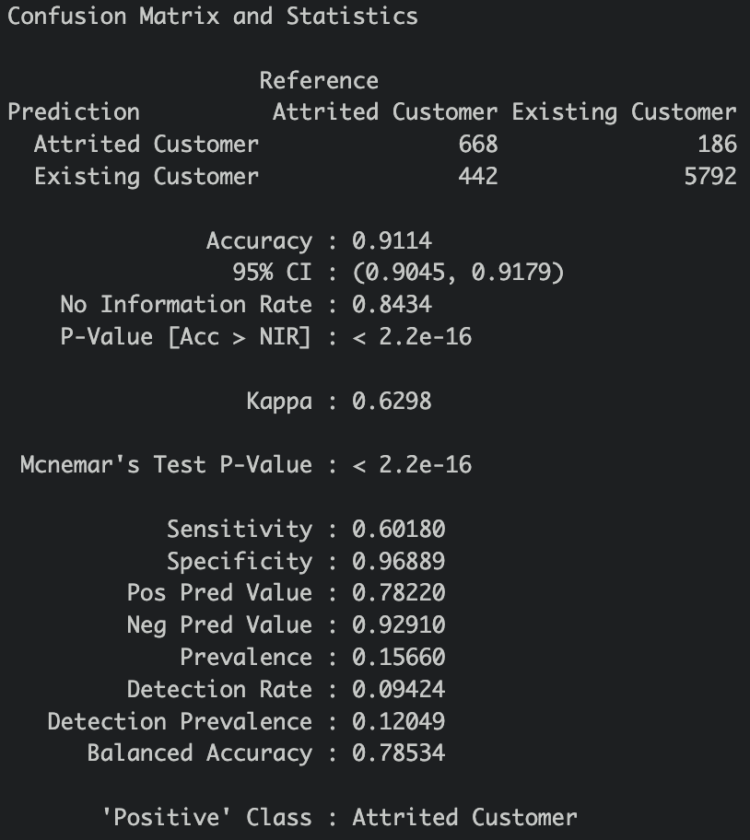
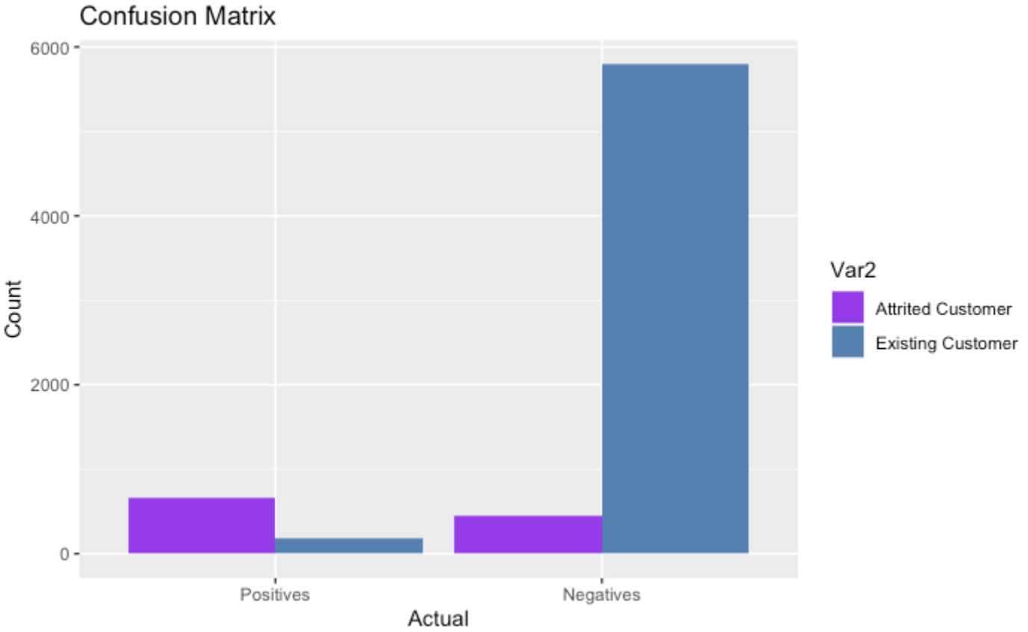
Naïve Bayes Method Train
Notes:
Accuracy in the context of a Naive Bayes confusion matrix refers to the proportion of correctly classified instances out of all instances. It is a measure of the overall performance of the classifier in predicting whether a customer will churn or not. and it is at 91.14%. which makes the miscalculation rate at 8.86%.
TP,FP FN, TN
The positive class are the past customers. The true positives for past customers is the 668 number where the model correctly predicts a customer will leave and they do.
The false positive is 186, where it predicts a customer will leave but they did not.
The false negative is 442 where the model predicts a customer will not leave but they do.
Lastly, the true negatives where existing customers were correctly classified was 5792, where a customer is predicted to stay and they do.

Slide 7
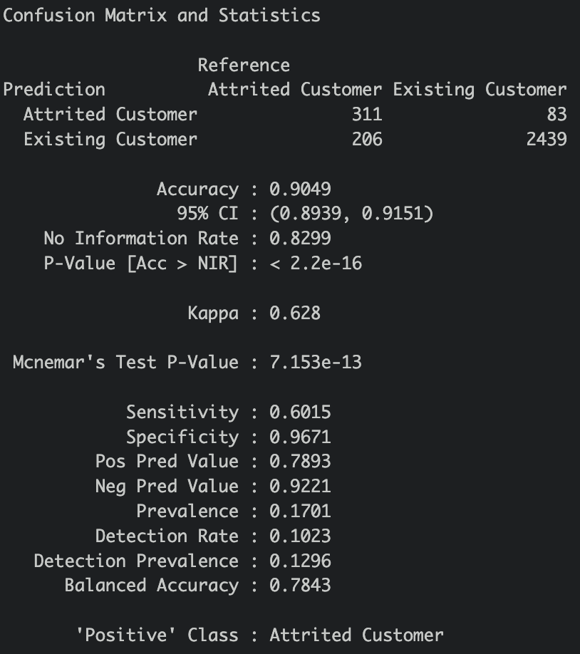
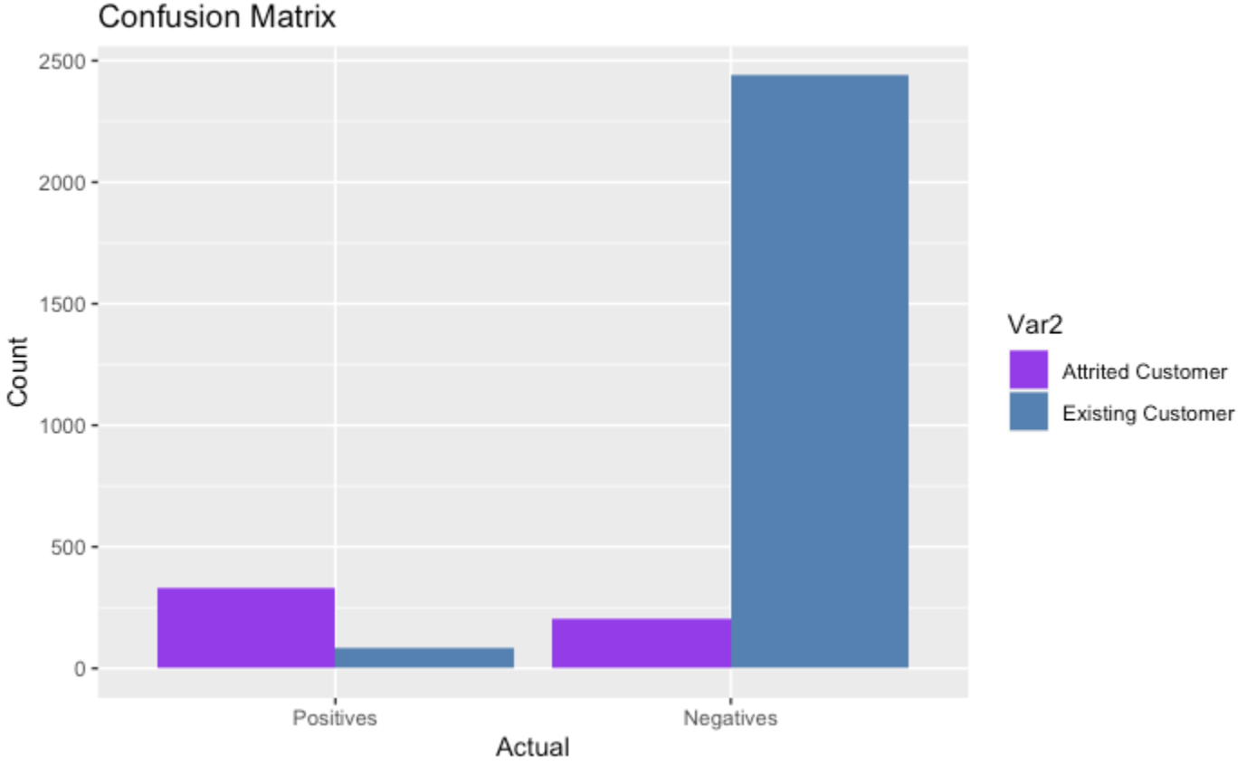
Naive Bayes Method Test
Notes:
Naive Bayes test set calculated an accuracy rate of 90.49%, which makes the miscalculation rate at 9.51%. This is not as favorable as the training set.
TP,FP FN, TN

Slide 8
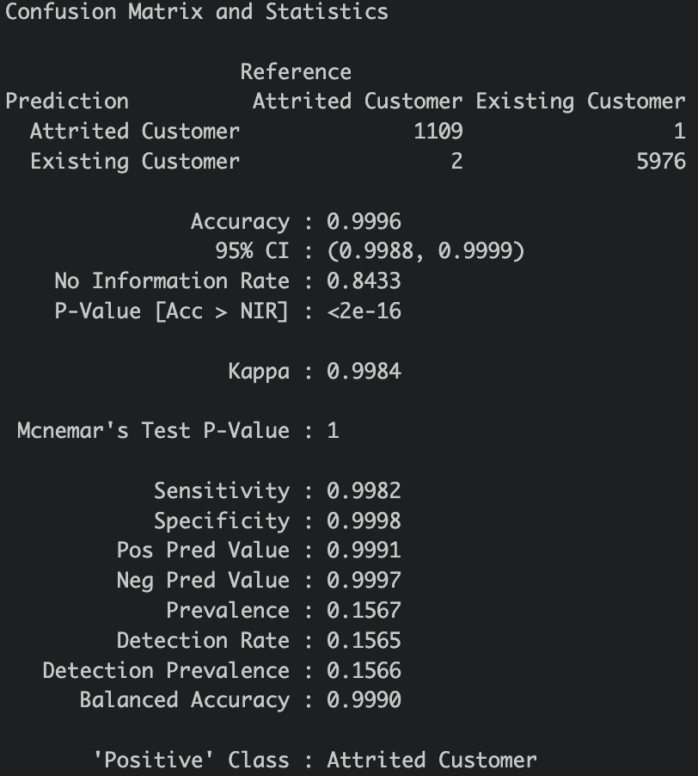
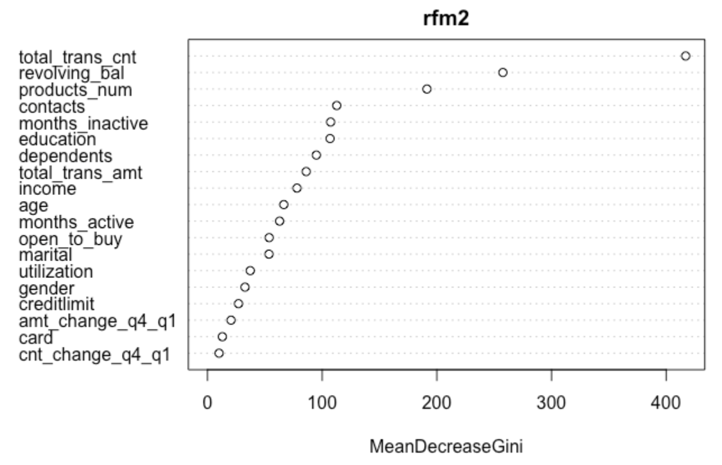
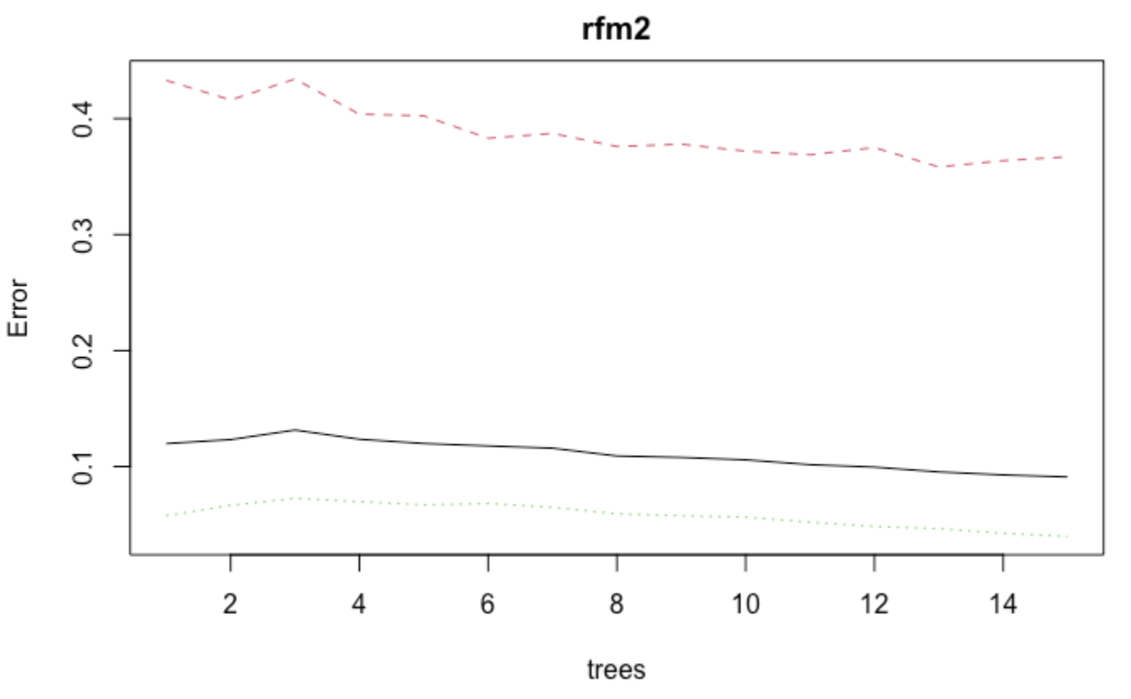
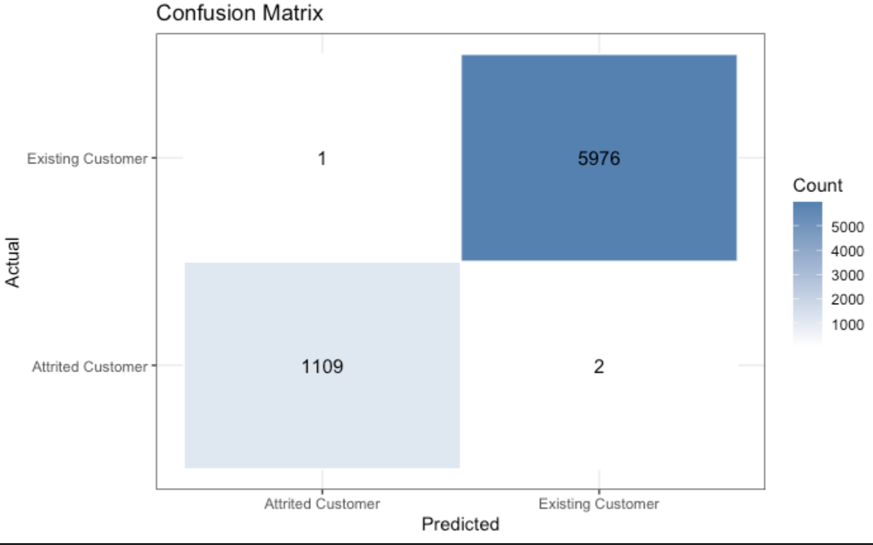
Random Forest
Notes:
With the variance importance plot helped us identify the most important variables that contributed to predicting the model within the random forest method and understand how it contributes to the model’s accuracy. This can be used to improve the model’s performance by focusing on the most important variables in the future. Looking at the variance importance plot, it falls in line with our apriori results, which is a good sign.
Now looking at the confusion matrix, the random forest model has been our best and most accurate model at 99.96%. There is 1 false positive and 2 false negatives.
1 false positive = model predicted that the customer will leave but they don’t.
2 false negative = model predicted the customer will not leave but they do.
TP, TN,
FP, FN

Slide 9
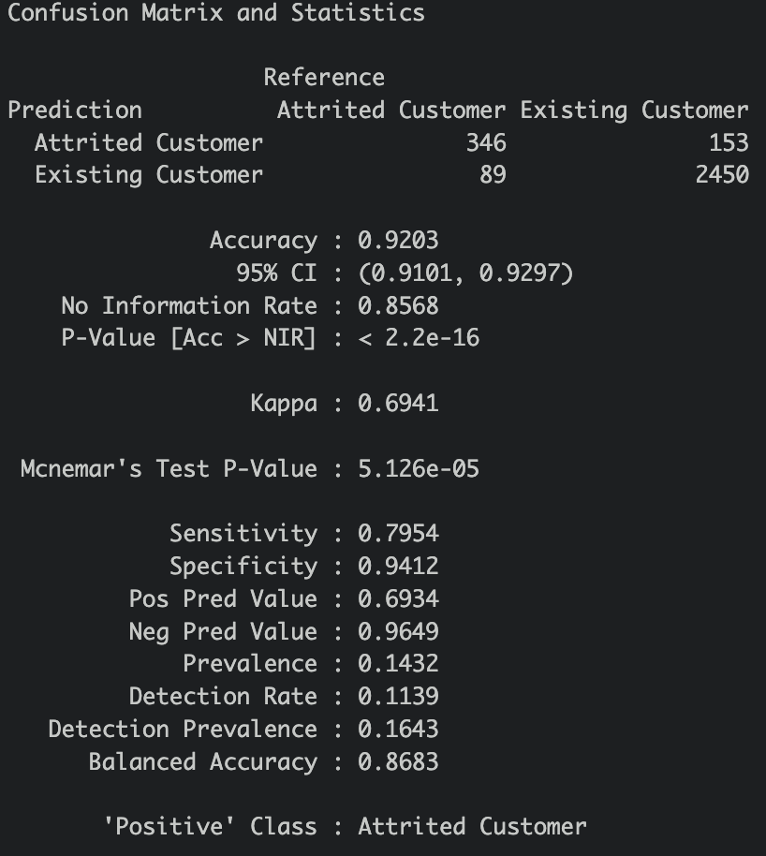
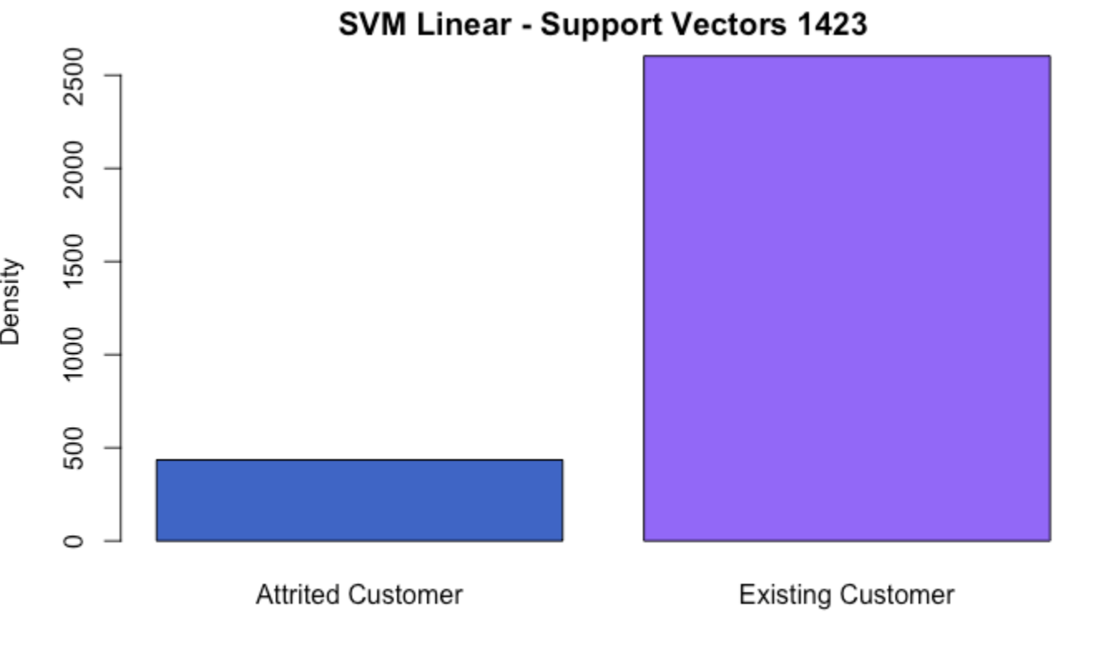
SVM: Linear

Slide 10
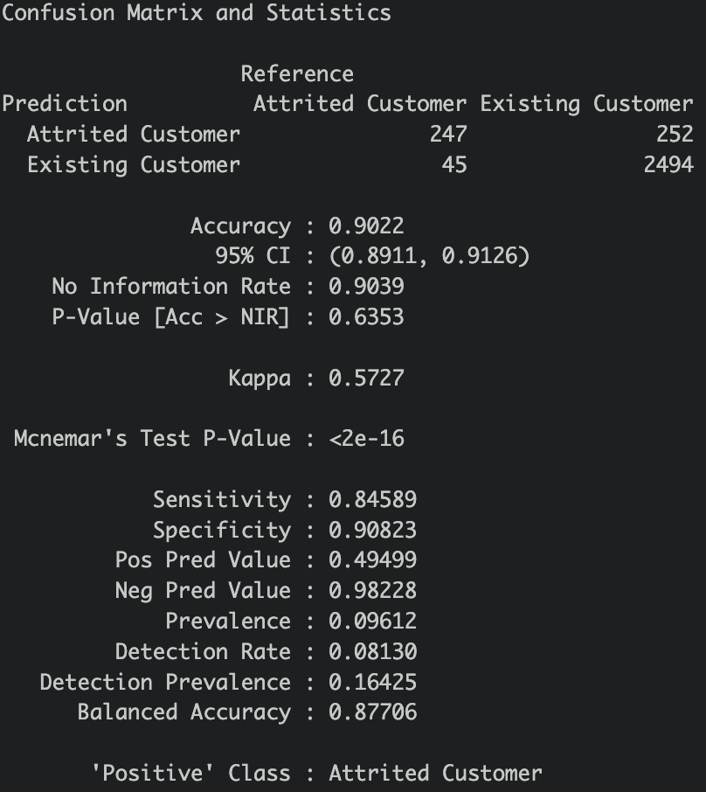
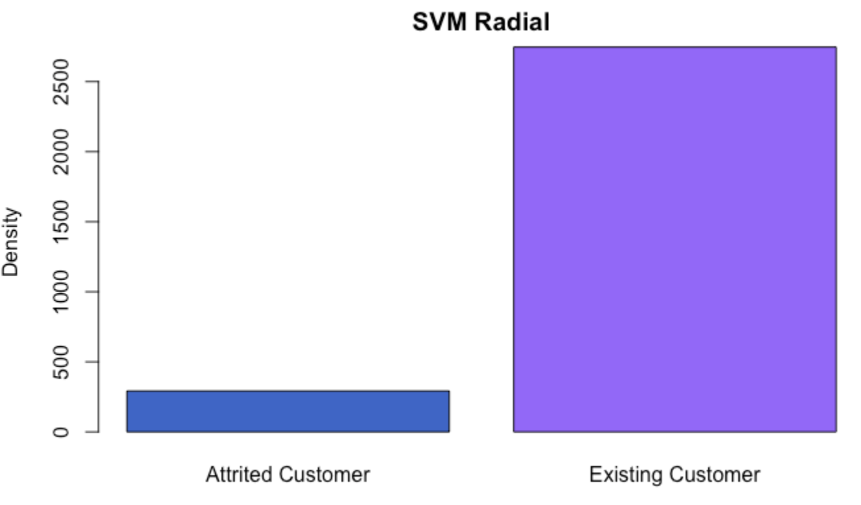
SVM: Radial
Notes:
SVM Linear has support Vectors 1423 and Accuracy of 92.03%
SVM Polynomial has 2468 supporting vectors with Accuracy of 83.57%
SVM Radial has 2120 Supporting Vectors with Accuracy of 90.22%
SVM Sigmoid had 2242 supporting vectors with Accuracy of 88.87%
Lesser Support Vectors is an indication of fastest test points calculation

Slide 11
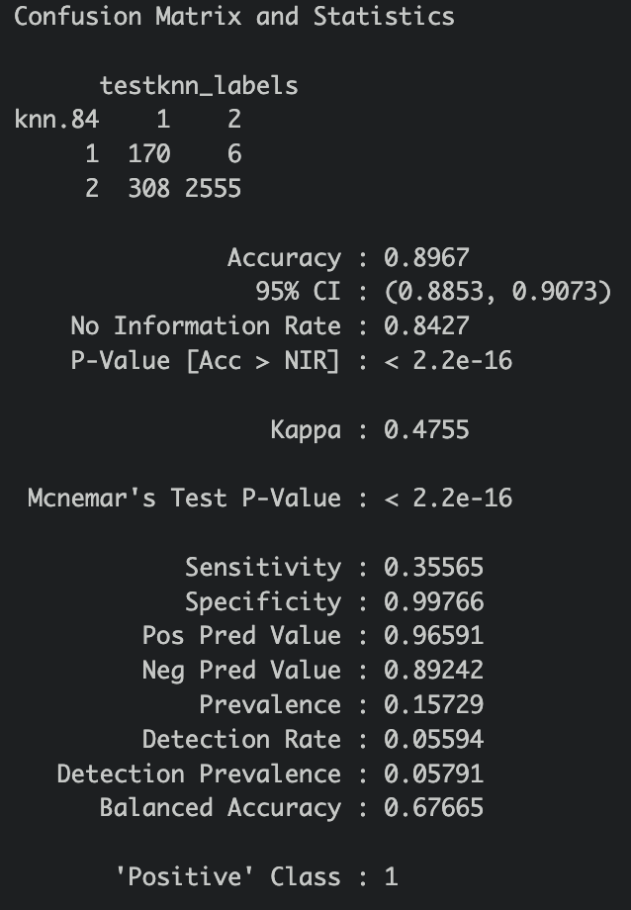
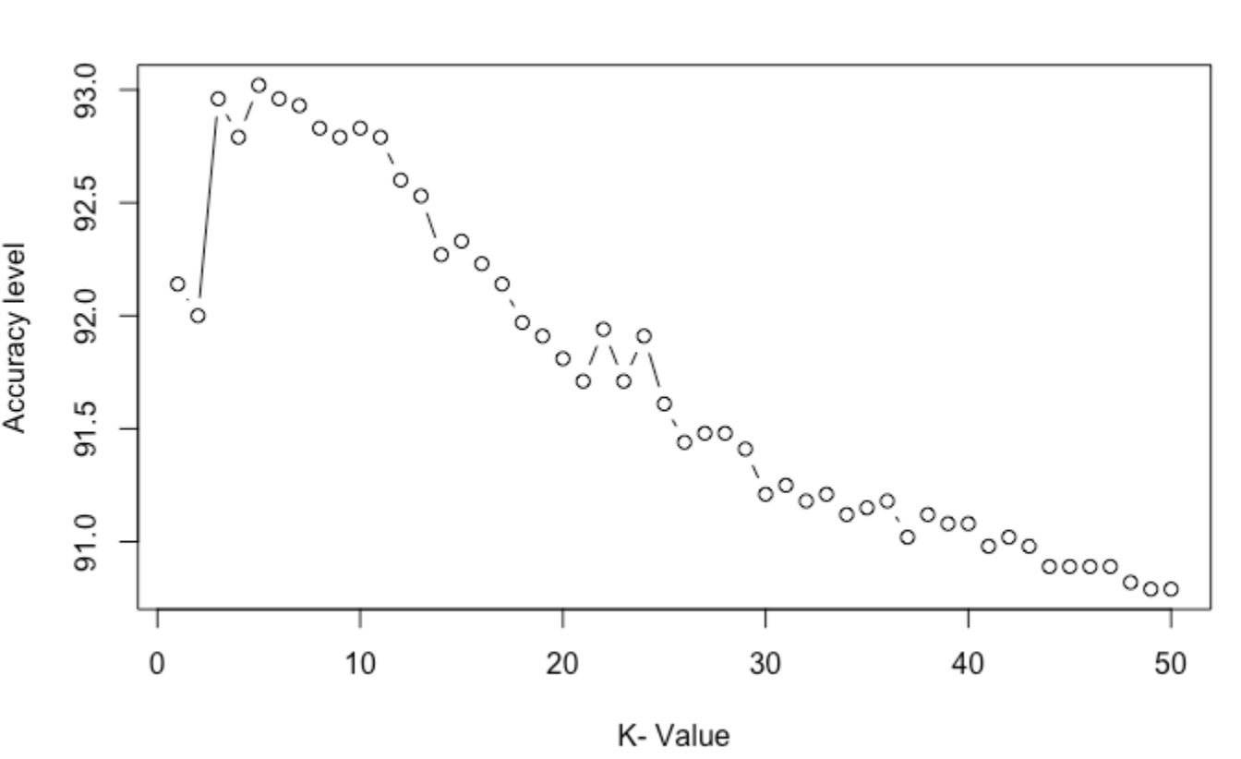
kNN
Notes:
Most accurate model is when k=5 at 93.09%(best k candidates are 3,4,5 –under 10)
KNN started with k as Sq.root of number of rows – 84 and 85 with an accuracy rate of ~89%.

Slide 12
Accuracy Comparision between Models
Model | Accuracy | Comments
Naïve Bayes | 91.14
SVM Linear | 92.03
SVM Polynomial | 83.57 | Cost Tuning did not produce much changes
SVM Radial | 90.22
kNN | 93.02 | K=5 ( From k=1 thru 50 and 84-85)
Random Forest | 99.96 | 15 Trees
Notes:
Our dataset had 20 columns with a smaller dimension – kNN works well in such scenarios with lower features.
Our problem is a classification problem and Random Forest works well with such cases. Our Recommendation is use RF

Slide 13
Conclusion and Recommendation
Random Forest provided a higher level of accuracy.
The Variables of Importance were
Transaction Count
Transactions Amount
Contacts
Revolving Balances
These are consistent with APRIORI Rules.
The Marketing Team can focus on the above data points and can reach out to the customers when they see a decline/change in the above variables
Additional Food for thought:
Data collection can be enhanced by sourcing additional details like
Spending Patterns
Credit Score
Usage of Rewards (if offered/used)/competitor data
Data is mainly focused on customer base and sometimes external factors such as Inflation, Pandemic etc. can influence decision making process.

